Slide 1
Simplicity
‘Simplicity’ is a fictional country with a total population of 10 million people. 40% of the population live in urban areas with 1.25 million households and 923 thousand households in the rural areas. The total population is expected to reach 15.9 million people by 2040 with an average annual growth rate of 1.8%. Currently, about 60% of the population is connected to the national grid and the government plans to electrify the rest 40% by 2030.
Simplicity relies on three power plants to meet its electricity demand. They are a combined cycle gas turbine, a large hydro power plant with dam storage and finally a wind power plant. The natural gas required to run the power plant either comes from the domestic natural gas resources or imported from neighbouring countries. Additionally, the government is planning to install a new combined cycle power plant running on natural gas to meet the future electricity demand.
Notes:
GNU MathProg is one of the simplest modelling languages. It is open-source and similar to GAMS. Equations written in GNU MathProg resemble equations written in the algebraic form, such as those one could write manually on paper.

Slide 2
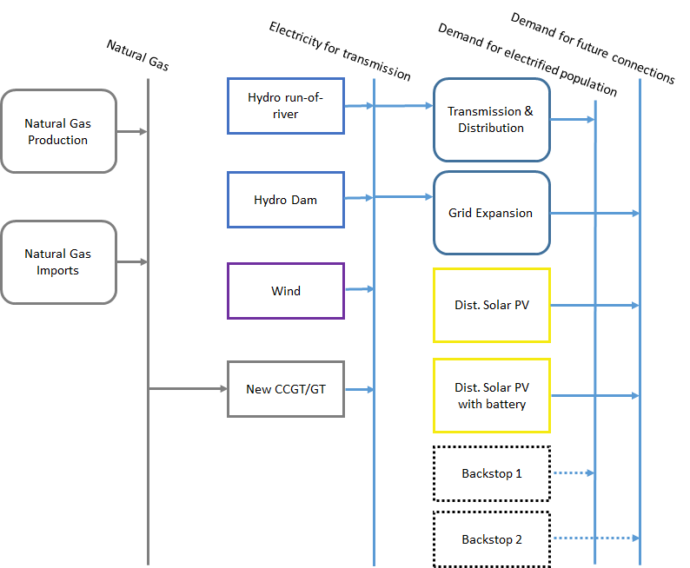
RES of Simplicity
Resources
Primary
Secondary
Final
We will reproduce this structure in MoManI step by step.
Notes:
GNU MathProg is one of the simplest modelling languages. It is open-source and similar to GAMS. Equations written in GNU MathProg resemble equations written in the algebraic form, such as those one could write manually on paper.

Slide 3
RES of Simplicity
Resources
Primary
Secondary
Final
We will reproduce this structure in MoManI step by step.
After initiating the model, we will define:
1) Demands
Notes:
GNU MathProg is one of the simplest modelling languages. It is open-source and similar to GAMS. Equations written in GNU MathProg resemble equations written in the algebraic form, such as those one could write manually on paper.

Slide 4
RES of Simplicity
Resources
Primary
Secondary
Final
We will reproduce this structure in MoManI step by step.
After initiating the model, we will define:
2) Backstop technologies
Backstop is an additional fictitious technology, directly linked to a demand and supplying the required fuel at a very high cost, without any constraint. Since the model minimizes cost, normally it is not chosen. It is chosen only when we make a mistake somewhere else and it becomes the only way to satisfy the demand. It rings an alarm bell for us, indicating something is wrong. Always have it in your models!
Notes:
GNU MathProg is one of the simplest modelling languages. It is open-source and similar to GAMS. Equations written in GNU MathProg resemble equations written in the algebraic form, such as those one could write manually on paper.

Slide 5
RES of Simplicity
Resources
Primary
Secondary
Final
We will reproduce this structure in MoManI step by step.
After initiating the model, we will define:
3) Primary supply
Notes:
GNU MathProg is one of the simplest modelling languages. It is open-source and similar to GAMS. Equations written in GNU MathProg resemble equations written in the algebraic form, such as those one could write manually on paper.

Slide 6
RES of Simplicity
Resources
Primary
Secondary
Final
We will reproduce this structure in MoManI step by step.
After initiating the model, we will define:
4) CCGT power plants and T&D
Notes:
GNU MathProg is one of the simplest modelling languages. It is open-source and similar to GAMS. Equations written in GNU MathProg resemble equations written in the algebraic form, such as those one could write manually on paper.

Slide 7
RES of Simplicity
Resources
Primary
Secondary
Final
We will reproduce this structure in MoManI step by step.
After initiating the model, we will define:
5) Hydro power plants
Notes:
GNU MathProg is one of the simplest modelling languages. It is open-source and similar to GAMS. Equations written in GNU MathProg resemble equations written in the algebraic form, such as those one could write manually on paper.

Slide 8
RES of Simplicity
Resources
Primary
Secondary
Final
We will reproduce this structure in MoManI step by step.
After initiating the model, we will define:
6) Wind and solar power plants
Notes:
GNU MathProg is one of the simplest modelling languages. It is open-source and similar to GAMS. Equations written in GNU MathProg resemble equations written in the algebraic form, such as those one could write manually on paper.

Slide 9
RES of Simplicity
Resources
Primary
Secondary
Final
We will reproduce this structure in MoManI step by step.
After initiating the model, we will define:
7) Emissions
Notes:
GNU MathProg is one of the simplest modelling languages. It is open-source and similar to GAMS. Equations written in GNU MathProg resemble equations written in the algebraic form, such as those one could write manually on paper.

